Slide 1
Thinking About Behavior in Augmented and Mobile Environments
Inspired by: Designing for Behavior Change
by Stephen Wendel

Slide 2
How Does One Begin Designing for Behavior Change? (1)
3 steps to envisioning a behavior change with design
Action: envision the target action to make it feasible
Environment: Construct the decision making environment to support the target action
User Interaction: prepare the users to take the target action
My early experiences with mobile and AR development would agree with this approach

Slide 3
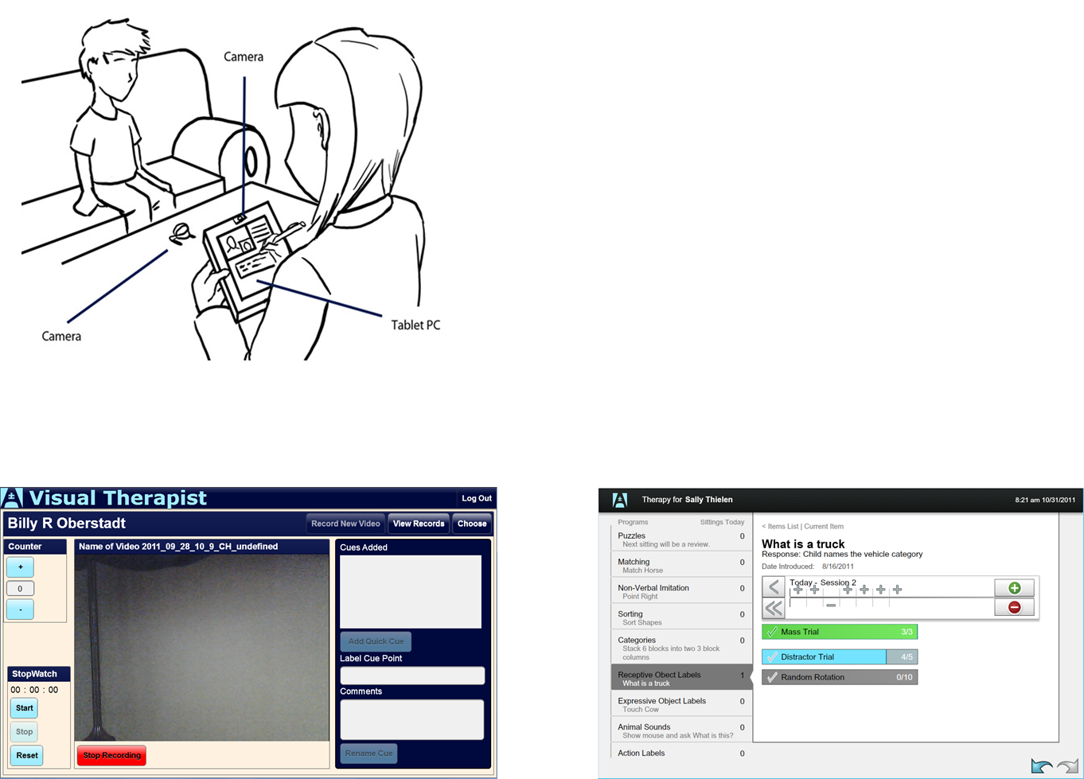
My First Major Mobile Project—Mobile Autism Therapy
Problem: Poor training and inter-rater reliability among autism therapy and medical providers
Action: Improve diagnostic and inter-rater reliability for therapists working with children by simple and trackable graphic interactions done in real time
Environment: Need to work within home & outside environments
User Interaction: graphic and intuitive video

Slide 4
How were we trying to change behavior with the Mobile Autism Applications?
We needed to involve the parents and medical doctors in behavior therapy
Parents were used to quarterly and semi annual reports
Doctors rarely (maybe once a year) saw behavior reports
Needed to reinforce looking at behavior on the part of new line therapists
Needed to show comprehensive and repetitive behaviors in children
Needed to match behaviors appropriately from a defined list
Needed a way to reinforce inter-rater reliability
Needed to move toward more comprehensive analysis

Slide 5
How does one reward behavior?
First we tend to work on autopilot
Researchers have found that roughly half of our life is on auto-pilot (Woods)
Rewarding behavior on a rational mind basis only may not change habits
Successful applications must take into account both overt and unconscious behavior—we must work with habits
Behavior is ordered and changed in a 3 step process
Cue: Something that clearly tells us how to act
Routine: Actions/behaviors that occur by routine and without much thought
Reward: Actions/behavior is rewarded (ideally immediately)

Slide 6
How did the Autism Apps use the behavior cycle?
We needed to keep in the habits of recording data that therapists were using
All therapies and results were recorded on paper either during or at the end of session
Cue/Routine: We needed to use the same system but on tablet
Therapists share notes on behavior as a means of understanding progress
Cue/Routine: Most new line therapists were uncertain on describing behavior—they learned thru observation and reference to notes
Cue/Routine: We needed to be able to link thru and share behaviors to increase reliability
Reward: We are able to streamline their reporting and graphing process

Slide 7
Additional Reward Cycle
Reward had to happen on three levels
First appealed to the therapists to streamline work
Second appealed to the parents—all results were instantly graph able
We could share reports with Medical doctors to coordinate therapies
Additionally we began integrating Corvid AI engine
Began watching senior therapist cycles in the methodologies
Looked for specific departures from established methodologies
Used cues in the applications to prompt for new behaviors
B12 shots and Speech Therapy

Slide 8
Where we failed
Mobile was too far ahead of most therapy companies
Average line therapist earned $9 per hour
Companies are strapped for cash to do the investment
Therapists distrust Medical Doctors and feared sharing their results

Slide 9
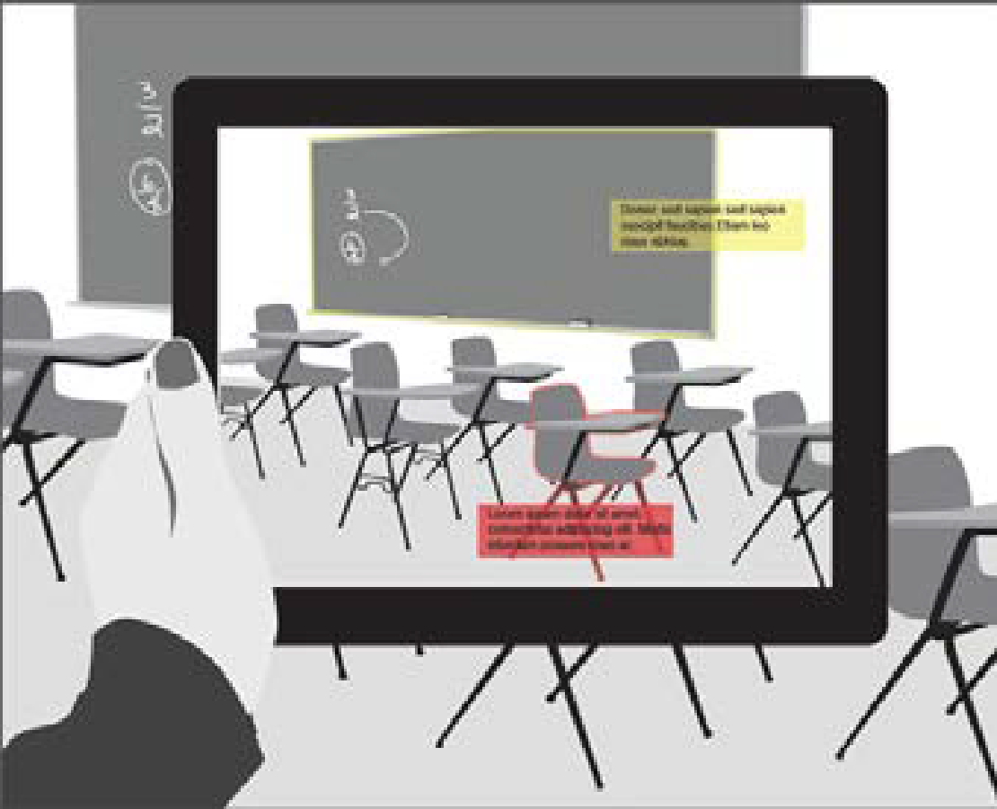
My first major Augmented Reality Project
Used the FlAR TookKit with Adobe AIR
Created in 2011
Meant to help children on Autism Spectrum
Used the FlAR TookKit with Adobe AIR
Teacher takes picture of class and can post Images/Text/Video on objects in the environment
All image recognition done on device—hampered by recognition points
We needed triangulation of sensors

Slide 10
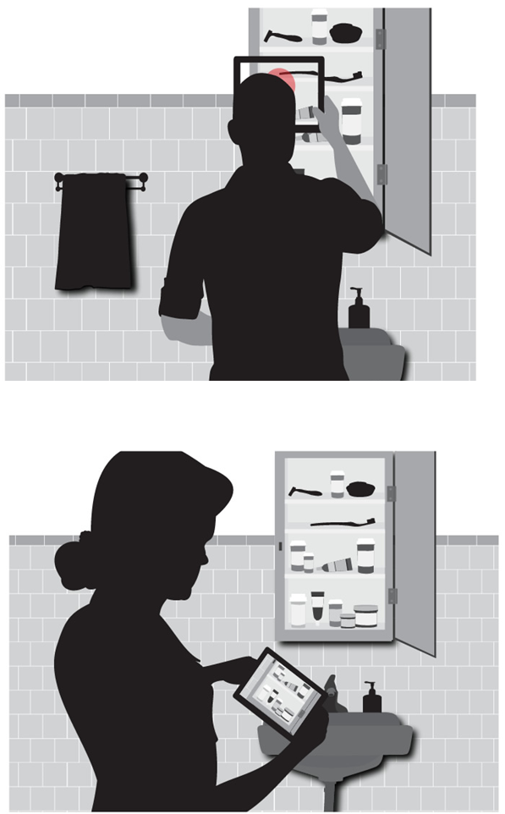
Taking one idea to the next level in AR
Based on our initial application we learned more about how to implement AR solutions
Needed IN2AR Web Service to hold targets
Needed more comprehensive field studies
Mobile Devices and Web Networks weren’t ready

Slide 11
Added Streaming Media Services to support AR
I moved to a combination of AR visual recognition (QR codes & some Object) with GPS and Account log in
Pitched out to hospitals for medical records and annotation
https://vimeo.com/65916510

Slide 12
Came to a series of realizations
Even when you map out action to environment you still have to worry about the user
The technology wasn’t able to do everything I wanted
Image recognition was too contrained
Media generation on artifacts needed a more streamlined process
The general end user still couldn’t see what was important about it
WiSys and WARF couldn’t see the end game for
Kids & therapists liked it/teachers were too busy to use it

